Slide 1
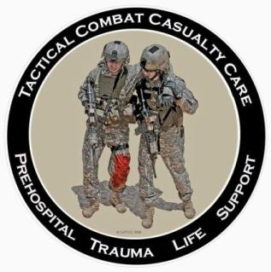
Tactical Combat Casualty Care
Tourniquets and Hemostatic Dressings
Notes:
The first phase of TCCC is Care Under Fire.

Slide 2
The Number One Medical Priority for Initial Management of Trauma Victims
Early control of severe hemorrhage is critical.
Prior to TCCC and effective battlefield tourniquets, extremity hemorrhage was the most frequent cause of preventable battlefield deaths.
Over 2500 deaths occurred in Vietnam secondary to hemorrhage from extremity wounds.
Injury to a major vessel can quickly lead to shock and death.
Only life-threatening bleeding warrants intervention during Care Under Fire.
Notes:
If you can only do ONE thing for the casualty – stop him from bleeding to death.
Do not treat minor bleeding during Care Under Fire.

Slide 3
When is bleeding life-threatening?
There is pulsatile or steady bleeding from the wound.
Blood is pooling on the ground.
The overlying clothes are soaked with blood.
Bandages or makeshift bandages used to cover the wound are ineffective and steadily becoming soaked with blood.
There is a traumatic amputation of the arm or leg.
There was prior bleeding, and the patient is now in shock (unconscious, confused, pale).
Notes:
These are indications that bleeding is or soon will be an imminent threat to the life of the casualty.

Slide 4
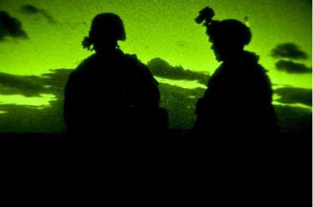
Question
How long does it take to bleed to death from a complete femoral artery and vein disruption?
Answer:
Casualties with such an injury can bleed to death in as little as 3 minutes
Notes:
10% of animals in lab studies died within 3 minutes without hemorrhage control measures.

Slide 5
Care Under Fire
Where a tourniquet can be applied, it is the first choice for control of life-threatening hemorrhage in Care Under Fire.
Notes:
Forget about direct pressure, pressure dressings, and anything else if you have severe extremity bleeding in the Care Under Fire phase.
Go directly to a tourniquet.

Slide 6
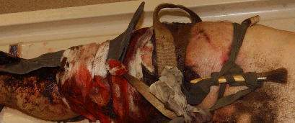
A Preventable Death
Did not have an effective tourniquet applied - bled to death from a leg wound
Notes:
The medic in this Army unit was killed in the battle in which this soldier was wounded.
Others in the unit attempted to control the bleeding from this soldier’s wound just below his left knee.
These improvised tourniquets were ineffective, and the soldier bled to death.
DON”T LET THIS HAPPEN TO YOUR BUDDIES!

Slide 7
Tourniquet Application
Apply without delay if indicated.
Both the casualty and the medic are in grave danger while a tourniquet is being applied in this phase – don’t use tourniquets for wounds with only minor bleeding.
The decision regarding the relative risk of further injury versus that of bleeding to death must be made by the person rendering care.
Notes:
Read text

Slide 8
Tourniquet Application
Apply the tourniquet without removing clothing – make sure it is clearly proximal to the bleeding site.
If you are uncertain about exactly where the major bleeding site is on the extremity (night operations, multiple wounds), apply the tourniquet “high and tight” (as proximal as possible) on the arm or leg.
Notes:
Read text.

Slide 9
Tourniquet Application
Tighten the tourniquet until bleeding is controlled.
If the first tourniquet fails to control the bleeding, apply a second tourniquet just above (proximal to) the first.
Don’t put a tourniquet directly over the knee or elbow.
Don’t put a tourniquet directly over a holster or a cargo pocket that contains bulky items.
Notes:
Read text.

Slide 10
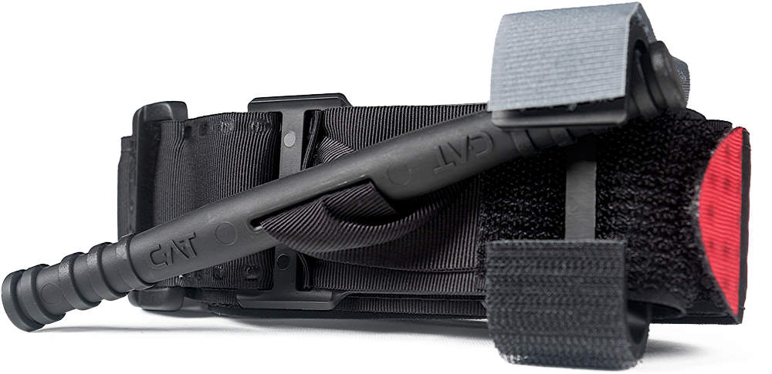
Instructions for One-Handed Application
Combat Application
Tourniquet
GEN 7
Courtesy of North American Rescue

Slide 11
Step 1
Insert the injured limb through the loop in the band and position tourniquet 2-3" above the bleeding site. If the most proximal bleeding site is not readily identifiable, place the tourniquet as high as possible on the limb.
Notes:
Read text.

Slide 12
Step 2
Pull band TIGHTLY and fasten it back on itself all the way around the limb, but not over the rod clips. Band should be tight enough that tips of three (3) fingers cannot be slid between the band and the limb. If the tips of three (3) fingers slide under band, retighten and re-secure.
Notes:
Read text.

Slide 13
Step 3
Twist the rod until bleeding has stopped.
Notes:
Read text.

Slide 14
Step 4
Snap the rod inside a clip to lock it in place. Check for bleeding and distal pulse. If bleeding is not controlled, or distal pulse is present, consider more tightening or applying a second tourniquet above and side-by-side to the first. Reassess.
Notes:
Read text.

Slide 15
Step 5
Route the band over the rod and between the clips. Secure with the grey securing strap. Record time of application.
Notes:
Read text.

Slide 16
Instructions for Two-Handed Application
Combat Application
Tourniquet
GEN 7
Courtesy of North American Rescue

Slide 17
Step 1
Route the band around the limb, pass the red tip through the slit of the buckle, and position tourniquet 2-3" above the bleeding site. If the most proximal bleeding site is not readily identifiable, place the tourniquet as high as possible on the limb.
Notes:
Read text.

Slide 18
Step 2
Pull band TIGHTLY and fasten it back on itself all the way around the limb, but not over the rod clips. Band should be tight enough that tips of three (3) fingers cannot be slid between the band and the limb. If the tips of three (3) fingers slide under band, retighten and re-secure.
Notes:
Read text.

Slide 19
Step 3
Twist the rod until bleeding has stopped.
Notes:
Read text.

Slide 20
Step 4
Snap the rod inside a clip to lock it in place. Check for bleeding and distal pulse. If bleeding is not controlled, or distal pulse is present, consider more tightening or applying a second tourniquet above and side-by-side to the first. Reassess.
Notes:
Read text.

Slide 21
Step 5
Route the band over the rod and between the clips. Secure with the grey securing strap. Record time of application.
Notes:
Read text.

Slide 22
After a Tourniquet has been Applied
After ANY tourniquet application, monitor the casualty closely to ensure that the tourniquet remains tight and that bleeding remains controlled.
Reassess – reassess- reassess!
Notes:
Read text.

Slide 23
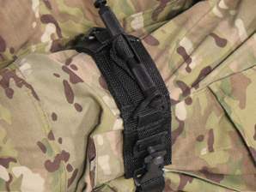
Other Tourniquets
The SOF Tactical Tourniquet (SOFTT) by Tactical Medical Solutions, Inc.
Equally recommended along with the C.A.T. by the CoTCCC for carriage by Combat Medics on the battlefield.
Photo courtesy TMS, Inc.
Notes:
The SOFTT is also recommended by ISR and the CoTCCC. It was found to be 100% effective in stopping arterial flow in arms and legs in laboratory testing. Anecdotal reports say the SOFTT may be more effective than the C-A-T in individuals with large legs. It is not fielded as widely as the C-A-T at present, but feedback from medics regarding its use has been good.
(NOTE: Instructional slides and a video for the SOFTT may be found in the Supplementary Modules folder.)

Slide 24
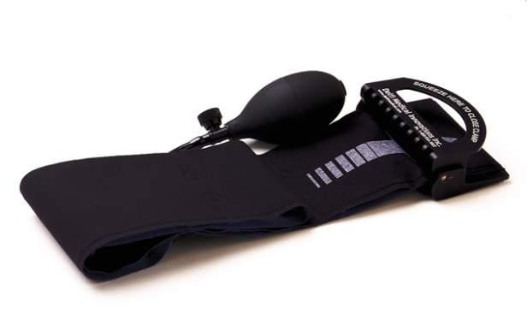
Other Tourniquets
Emergency and Military Tourniquet (EMT) by Delfi Medical Innovations, Inc.
The EMT is and excellent tourniquet and is recommended by the CoTCCC for use in evacuation platforms and medical treatment facilities, but not for carriage by medics on the battlefield at this point.
Photo courtesy Wafflephile/Wikipedia
Notes:
The EMT from Delfi was found to be as effective as the C-A-T in testing at the ISR. It was found to be better than the C-A-T in reports from Military Treatment Facilities in theater. The EMT is significantly more expensive.

Slide 25
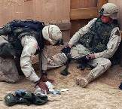
Impact of Tourniquet Use Kragh - Annals of Surgery 2009
Ibn Sina Hospital, Baghdad, 2006
Tourniquets are saving lives on the battlefield
Better survival when tourniquets were applied BEFORE
casualties went into shock
31 lives saved in this study by applying
tourniquets prehospital rather than in the ED
Estimated 1000-2000 lives saved as of 2008 by
tourniquets (data provided to Army Surgeon General via
an internal communication)
Notes:
Most importantly – apply tourniquets ASAP when they are needed.
Survival is improved if shock is prevented.

Slide 26
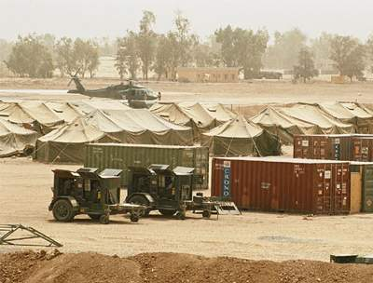
Safety of Tourniquet Use Kragh - Journal of Trauma 2008
Combat Support Hospital in Baghdad
232 patients with tourniquets on 309 limbs
CAT was best field tourniquet
No amputations caused by tourniquet use
Approximately 3% transient nerve palsies
Notes:
Remember at the start of the GWOT, we were still losing casualties to extremity hemorrhage.
We’re doing much better now.
This study documented 232 LIVES SAVED in this ONE hospital in a ONE-YEAR period.
MINIMAL complications from tourniquet use.

Slide 27
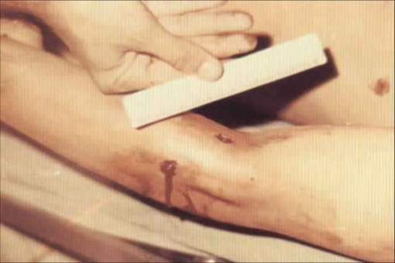
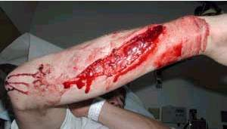
Examples of Extremity Wounds That Do NOT Need a Tourniquet
Use a tourniquet ONLY
for severe bleeding!
Notes:
Neither wound is life threatening - bleeding is minimal.
A tourniquet should not be used on these two wounds or other wounds like them where the bleeding is not severe.

Slide 28
Tourniquet Mistakes to Avoid!
Not using one when you should
Using a tourniquet for minimal bleeding
Putting it on too proximally if the bleeding site is clearly visible
Not taking it off when indicated during TFC
Taking it off when the casualty is in shock or has only a short transport time to the hospital
Not making it tight enough – the tourniquet should both stop the bleeding AND eliminate the distal pulse
Not using a second tourniquet if needed
Waiting too long to put the tourniquet on
Periodically loosening the tourniquet to allow blood flow to the injured extremity
* These lessons learned have been written in blood. *
Notes:
These are common mistakes made by first responders applying tourniquets.

Slide 29
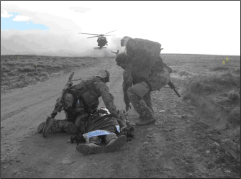
Tourniquet Pain
Tourniquets HURT when applied effectively
Does not necessarily indicate a mistake in application
Does not mean you should take it off!
Manage pain per TCCC Guidelines
Notes:
It is expected that tourniquet application will cause some pain, but it will also save your casualty’s life.

Slide 30
Tourniquets: Points to Remember
Damage to the arm or leg is rare if the tourniquet is left on for less than two hours.
Tourniquets are often left in place for several hours during surgical procedures.
In the face of massive extremity hemorrhage, it is better to accept the small risk of damage to the limb than to have a casualty bleed to death.
Notes:
30
Tourniquets have historically been frowned upon in civilian trauma settings.
In combat settings, they are the biggest lifesaver on the battlefield!
They are NOT A PROBLEM if not left in place for too long.

Slide 31
Tourniquets: Points to Remember
Every effort should be made to convert tourniquets in less than 2 hours if bleeding can be controlled with other means. If bleeding remains controlled with Combat Gauze, leave the loosened tourniquet in place. If the bleeding is not controlled with Combat Gauze, re-tighten the tourniquet until bleeding stops.
Restoring blood flow to the limb by transitioning to Combat Gauze at the 2-hour mark will minimize the chance of ischemic damage due to the tourniquet.
Notes:
31
Read text.

Slide 32
Tourniquets: Points to Remember
Tightening the tourniquet enough to eliminate the distal pulse will help to ensure that all bleeding is stopped, and that there will be no damage to the extremity from blood entering the extremity but not being able to get out.
Notes:
32
This condition is called Compartment Syndrome, as mentioned above.
It can cause unnecessary loss of the extremity.

Slide 33
Tourniquets: Points to Remember
Do not attempt to remove the tourniquet if:
The casualty is in shock.
You cannot closely monitor the wound for re-bleeding.
The extremity distal to the tourniquet has been traumatically amputated.
The tourniquet has been on for more than 6 hours.
The casualty will arrive at a medical treatment facility within 2 hours after time of application.
Tactical or medical considerations make transition to other hemorrhage control methods inadvisable.
Notes:
33
Pay very close attention to these rules about tourniquet removal.

Slide 34
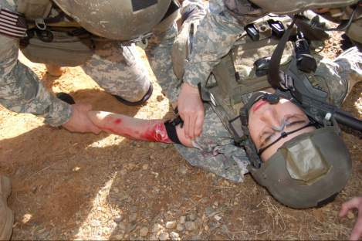
Tourniquets: Points to Remember
Only medics, physician assistants, or physicians should re-position or convert tourniquets.
Notes:
34
Read text.

Slide 35
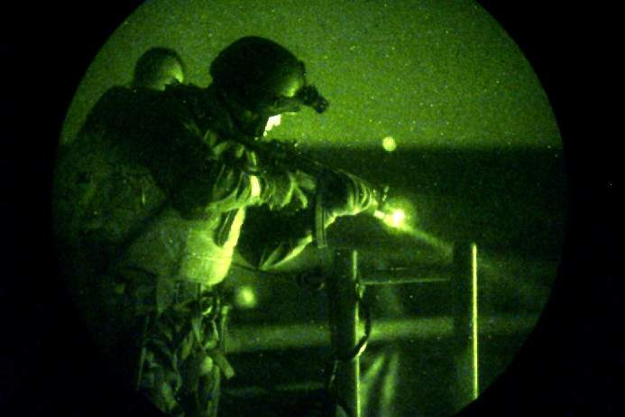
Tourniquet Practical
Notes:
For practicals:
Break up into small groups
About 6 or 7 students per instructor
Use skill sheets in the TCCC curriculum that go with each practical

Slide 36
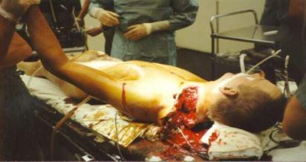
External Bleeding – Where you Can’t Use a Tourniquet
Groin, axilla
Neck
Use a hemostatic dressing!
36
Notes:
Injuries in these areas can result in bleeding from very large arteries and veins.

Slide 37
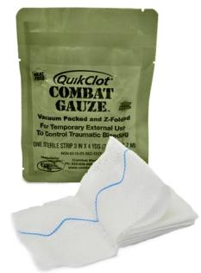
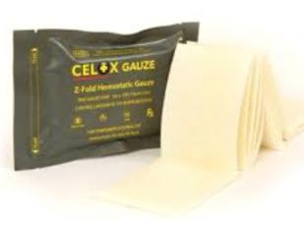
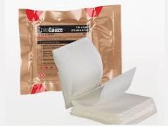
CoTCCC-Recommended Hemostatic Dressings
Combat Gauze Celox Gauze ChitoGauze
* Always apply with 3 minutes of firm direct pressure!
Notes:
These are the three hemostatic dressings recommended in the TCCC guidelines.
Two reasons that Combat Gauze is preferred over other two.
1) Military has much more experience with CG and it has worked very well.
2) Celox Gauze and Chito-Gauze” have not been tested in the US Army Institute of Surgical Research safety model.
Combat Gauze has.
But military does have experience with chitosan-coated hemostatic dressings (similar to Celox Gauze and ChitoGauze) from the early years of the war.
And there were no adverse effects from chitosan use noted.

Slide 38
Combat Gauze When You Can’t Use a Tourniquet
“The 88.6% self-reported success rate in junctional hemorrhage control is encouraging, as junctional hemorrhage is increasingly looked at as the currently most common cause of preventable death in the battlefield.”
Dr. Avi Shina et al
Journal of Trauma 2015
Notes:
This recent study from the Israeli Defense Force is the largest case series of Combat Gauze use on the battlefield ever published.
And it shows excellent success with Combat Gauze use.

Slide 39
Slide – Mr.
Mike Meoli
Notes:
There are reports out there of LEOs being saved with Combat Gauze as well.
Another case from Mike Meoli in San Diego.

Slide 40
Combat Gauze
Tested in the ISR safety model
Widely fielded in the DoD
Case series from the battlefield and the civilian sector:
CG is effective at stopping bleeding
No safety issues reported
Recommended by CoTCCC as first choice for hemostatic dressing
Notes:
The CoTCCC recommends QuikClot Combat Gauze as the hemostatic dressing of choice.

Slide 41
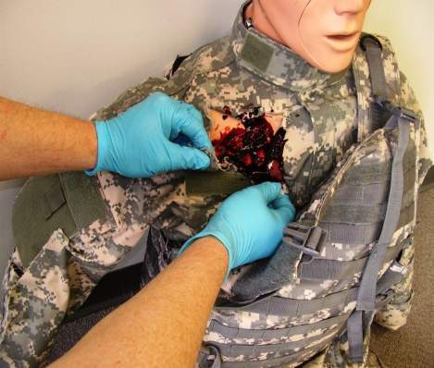
Combat Gauze Directions (1) Expose Wound & Identify Bleeding
Open clothing around the wound.
If possible, remove excess pooled blood from the wound while preserving any clots already formed in the wound.
Locate the source of the most active bleeding.
Combat Medical Systems, LLC, Tel: 910-426-0003, Fax: 910-426-0009, Website: www.combatgauze.com
Notes:
41
41
Read Text

Slide 42
Combat Gauze Directions (2) Pack Wound Completely
Pack Combat Gauze tightly into wound and directly onto the source of bleeding.
More than one gauze may be required to stem blood flow.
Combat Gauze may be re-packed or adjusted in the wound to ensure proper placement.
Combat Medical Systems, LLC, Tel: 910-426-0003, Fax: 910-426-0009, Website: www.combatgauze.com
Notes:
42
42
Pack CG into wound just like you would plain gauze.
If more than one roll is needed, pack in more CG until the wound is full.

Slide 43
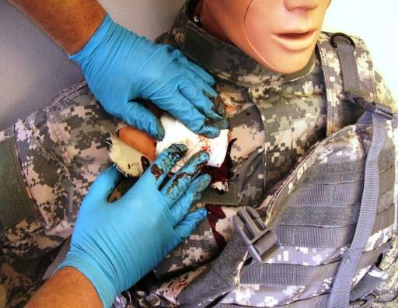
Combat Gauze Directions (3) Apply Direct Pressure
Quickly apply pressure until bleeding stops.
Hold continuous pressure for 3 minutes.
Reassess to ensure bleeding is controlled.
Combat Gauze may be repacked or a second gauze used if initial application fails to provide hemostasis.
Combat Medical Systems, LLC, Tel: 910-426-0003, Fax: 910-426-0009, Website: www.combatgauze.com
Notes:
43
43
Although the Combat Gauze may become saturated during the initial application process, continue to hold firm pressure for at least three minutes. The kaolin will continue to leach into the wound area and help form a clot even though the bandage is soaked through.

Slide 44
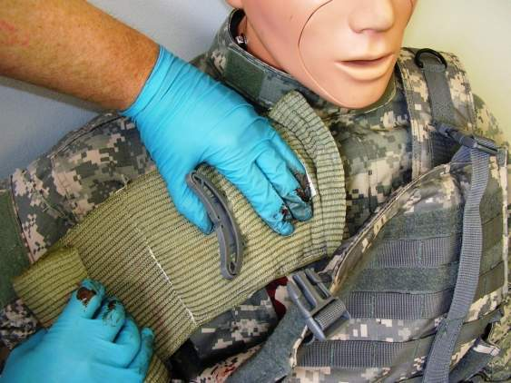
Combat Gauze Directions (4) Bandage over Combat Gauze
Leave Combat Gauze in place.
Wrap to effectively secure the dressing in the wound.
Although the Emergency Trauma Bandage is shown in this picture, the wound may be secured with any compression bandage, Ace wrap, roller gauze, or cravat.
Combat Medical Systems, LLC, Tel: 910-426-0003, Fax: 910-426-0009, Website: www.combatgauze.com
Notes:
44
44
Carefully observe for blood continuing to flow from under the gauze to determine if bleeding has been controlled. Once you are sure the bleeding has stopped, apply a pressure bandage over the Combat Gauze.

Slide 45
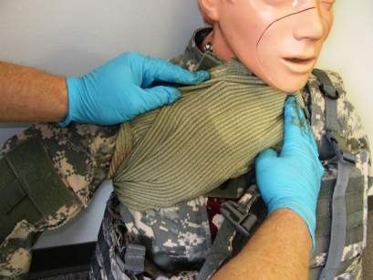
Combat Gauze Directions (5) Transport & Monitor Casualty
Do not remove the bandage or Combat Gauze.
Reassess frequently to monitor for recurrent bleeding
Transport casualty to next level of medical care as soon as possible.
Combat Medical Systems, LLC, Tel: 910-426-0003, Fax: 910-426-0009, Website: www.combatgauze.com
Notes:
45
45
Re-check the dressing frequently, especially while transporting the casualty to next level of care.
Watch for re-bleeding.

Slide 46
Alternative Hemostatic Agents
Celox Gauze
ChitoGauze
May be used if Combat Gauze is not available
Active ingredient is chitosan, a mucoadhesive
Function is independent of coagulation cascade
There are case series that report that chitosan dressings have stopped bleeding in surgical patients with life-threatening bleeding and severe coagulopathy
Does not cause reactions in persons allergic to shellfish
Notes:
Read text.

Slide 47
Alternative Hemostatic Agents
Celox Gauze and ChitoGauze are as effective as Combat Gauze at hemorrhage control in laboratory studies:
Neither ChitoGauze nor Celox Gauze have been tested in the USAISR safety model, but
Chitosan-based hemostatic dressings have been used in combat since 2004 with no safety issues reported.
Notes:
Read text.

Slide 48
CoTCCC-Recommended Hemostatic Agents
For more information:
Combat Gauze
http://www.z-medica.com/military/Home.aspx
Celox Gauze
http://www.celoxmedical.com/usa/products/celox-gauze/
ChitoGauze
http://www.hemcon.com/Products/ChitoGauzeHemostaticGauzeOverview.aspx
Notes:
Further information on these products is available on the manufacturers’ websites.

Slide 49
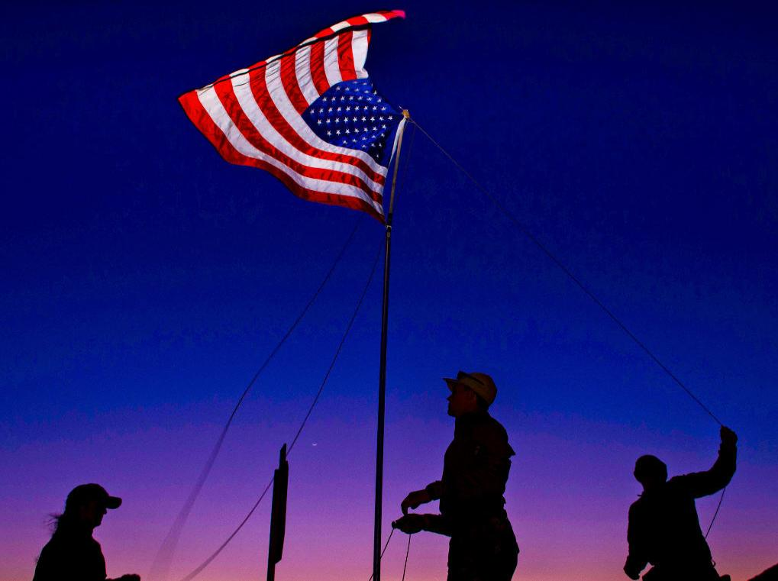
Thank You!
49
Notes:
Thank you for your presence and your attention here today.
And all that you do to help keep us safe every day.

