Slide 1
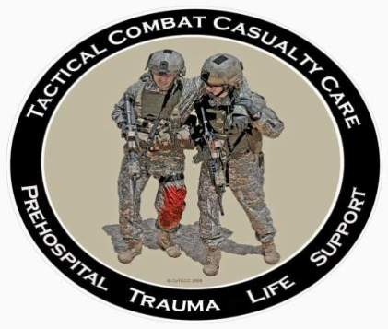
Tactical Combat Casualty Care for Medical Personnel August 2018 (Based on TCCC-MP Guidelines 180801)
Tactical Field Care 1a
Introduction to Tactical Field Care
Notes:
Next we’ll be moving into the Tactical Field Care phase of TCCC.

Slide 2
Disclaimer
“The opinions or assertions contained herein are the private views of the author and are not to be construed as official or as reflecting the views of the Departments of the Army, Air Force, Navy or the Department of Defense.”
No disclosures

Slide 3
LEARNING OBJECTIVES
Terminal Learning Objective
Perform Tactical Field Care
Enabling Learning Objectives
Identify the importance of perimeter security in tactical field care.
Identify the common causes of altered mental status on the battlefield.
Identify the importance of disarming and securing communications gear of a casualty with altered mental status.
Notes:
Read the text.

Slide 4
LEARNING OBJECTIVES
Enabling Learning Objectives
Describe the prioritization of treating life-threatening conditions using a tactical trauma assessment sequence such as the MARCH algorithm.
Identify triage considerations in tactical field care.
Determine appropriate treatment techniques for preventable causes of combat death.
Demonstrate a Tactical Trauma Casualty Assessment.
Notes:
Read the text.

Slide 5
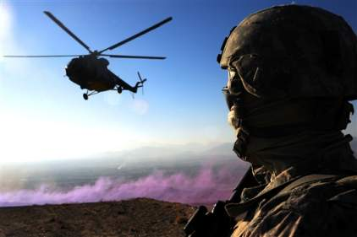
Tactical Field Care
Distinguished from Care Under Fire by:
A reduced level of hazard from hostile fire
More time available to provide care based on the tactical situation
Medical gear is still limited to that carried by the medic or corpsman
or unit members (may
include gear in tactical
vehicles)
Notes:
Now the shooting has stopped – or the enemy’s fire is ineffective.
This doesn’t mean that the danger is over – the situation could change to Care Under Fire again at any time.

Slide 6
Tactical Field Care
May consist of rapid treatment of the most serious wounds with the expectation of a re-engagement with hostile forces at any moment, or
There may be ample time to render whatever care is possible in the field.
Time to evacuation may vary from minutes to several hours or longer.
Notes:
This phase of care may be very prolonged.

Slide 7
Battlefield Priorities in the Tactical Field Care Phase
The TFC presentations cover the care to be recommended in TFC.
You must deal with your tactical situation and your casualties.
The sequence of care in TFC is compatible with the MARCH algorithm found in the USSOCOM Tactical Trauma Protocols.
Notes:
You may have multiple casualties with multiple problems, and you will deliver care in light of the tactical situation. You are on a battlefield.
What problems do you address first?

Slide 8
MARCH
Massive hemorrhage – control life-threatening bleeding.
Airway – establish and maintain a patent airway.
Respiration – decompress suspected tension pneumothorax, seal open chest wounds, and support ventilation/oxygenation as required.
Notes:
The MARCH algorithm is a guide to the sequence of treatment priorities in caring for combat casualties.

Slide 9
MARCH
Circulation – establish IV/IO access and administer fluids as required to treat shock.
Head injury/Hypothermia – prevent/treat hypotension and hypoxia to prevent worsening of traumatic brain injury and prevent/treat hypothermia.
Notes:
Read the text.

Slide 10
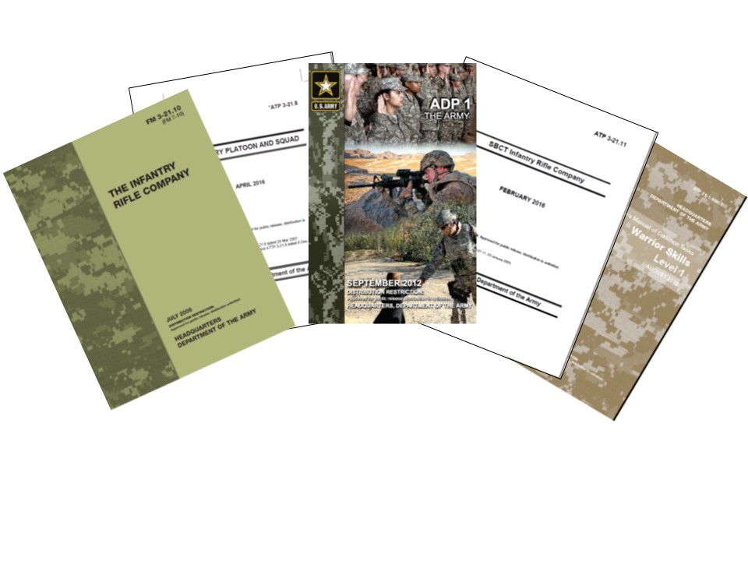
Tactical Field Care Guidelines
1. Establish a security perimeter in accordance with unit tactical standard operating procedures and/or battle drills. Maintain tactical situational awareness.
Notes:
Read the guideline.
(Note: All of the slides entitled “Tactical Field Care Guidelines” - as this one is - should be read verbatim.)
Security practices are prescribed in tactics, techniques, and procedures manuals. Know yours.

Slide 11
Tactical Field Care Guidelines
2. Triage casualties as required. Casualties with an altered mental status should have weapons and communications equipment taken away immediately.
Notes:
Read the guideline.
Weapons and radios do not mix well with shock or narcotics!

Slide 12
Manage Casualties with Altered Mental Status
A combatant with an altered mental status may use his weapons or radios inappropriately.
Secure long gun, pistols, knives, grenades, explosives, and all communications gear.
Possible causes of altered mental status are Traumatic Brain Injury (TBI), shock, hypoxia, and pain medications.
Say to the casualty: “Let Smith hold your weapon for you while I check you out.”
Notes:
You should take all weapons and radios away from any casualty who is not alert and fully oriented to the tactical situation. A confused or disoriented casualty may resist being disarmed. The proposed comment in the last bullet may help him to better accept your taking his weapon.

Slide 13
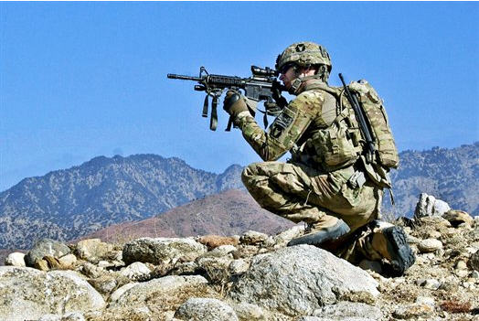
Questions?

