Slide 1
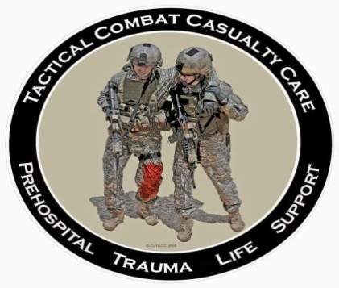
Tactical Combat Casualty Care for Medical Personnel August 2018 (Based on TCCC-MP Guidelines 180801)
Tactical Field Care 2c
Hypothermia Prevention
Notes:
Let’s talk about hypothermia prevention.

Slide 2
Disclaimer
“The opinions or assertions contained herein are the private views of the authors and are not to be construed as official or as reflecting the views of the Departments of the Army, Air Force, Navy or the Department of Defense.”
There are no conflict of interest disclosures
Notes:
Read the disclaimer.

Slide 3
LEARNING Objectives
Terminal Learning Objective
Perform hypothermia prevention measures on a trauma casualty in Tactical Field Care.
Enabling Learning Objectives
Identify the importance of hypothermia prevention of a trauma casualty in tactical field care – minimizing coagulopathy.
Describe the progressive strategies for hypothermia prevention in Tactical Field Care.
Notes:
Read the text.

Slide 4
Tactical Field Care Guidelines
7. Hypothermia Prevention
a. Minimize casualty’s exposure to the elements. Keep protective gear on or with the casualty if feasible.
b. Replace wet clothing with dry if possible. Get the casualty onto an insulated surface as soon as possible.
c. Apply the Ready-Heat Blanket from the Hypothermia Prevention and Management Kit (HPMK) to the casualty’s torso (not directly on the skin) and cover the casualty with the Heat-Reflective Shell (HRS).
Notes:
Read the guidelines.

Slide 5
Tactical Field Care Guidelines
7. Hypothermia Prevention
d. If an HPMK is not available, the previously recommended combination of the Blizzard Survival Blanket and the Ready Heat blanket may also be used.
e. If the items mentioned above are not available, use dry blankets, poncho liners, sleeping bags, or anything that will retain heat and keep the casualty dry.
f. Warm fluids are preferred if IV fluids are required.
Notes:
Read the guidelines.

Slide 6
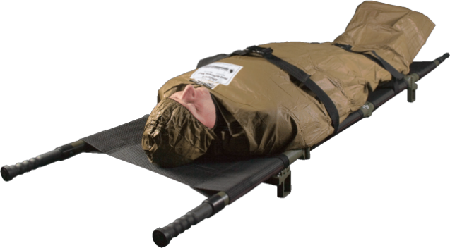
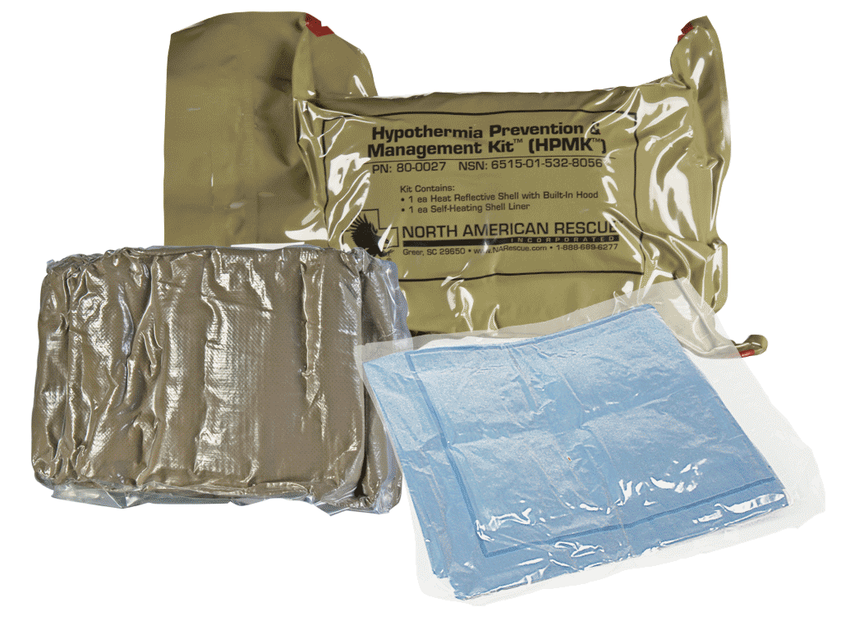
HPMK
Notes:
This is the Hypothermia Prevention and Management Kit with a Ready-Heat Blanket and a Heat Reflective Shell. The HRS will help to retain the heat produced by the Ready-Heat blanket. It has an incorporated hood and Velcro closures down each side to allow exposure of an arm or a leg. Such exposure allows the medic to attend to IVs and tourniquets.
6

Slide 7
Hypothermia Prevention Video
Notes:
Click on the photo to play the video.

Slide 8
Hypothermia Prevention
Key Point: Even a small decrease in body temperature can interfere with blood clotting and increase the risk of bleeding to death.
Casualties in shock are unable to generate body heat effectively.
Wet clothes and helicopter evacuations increase body heat loss.
Remove wet clothes and cover casualty with hypothermia prevention gear.
Do not put the Ready-Heat blanket directly on the skin.
Hypothermia is much easier to prevent than to treat!
Notes:
Here we’re not talking about hypothermia in the usual sense, which is dying from cold exposure.
Here we are talking about keeping your blood clotting system working!
Hypothermia is a problem for casualties with hemorrhagic shock even with warm ambient temperatures.
Prevention of hypothermia is the key; once established it is difficult to reverse.

Slide 9
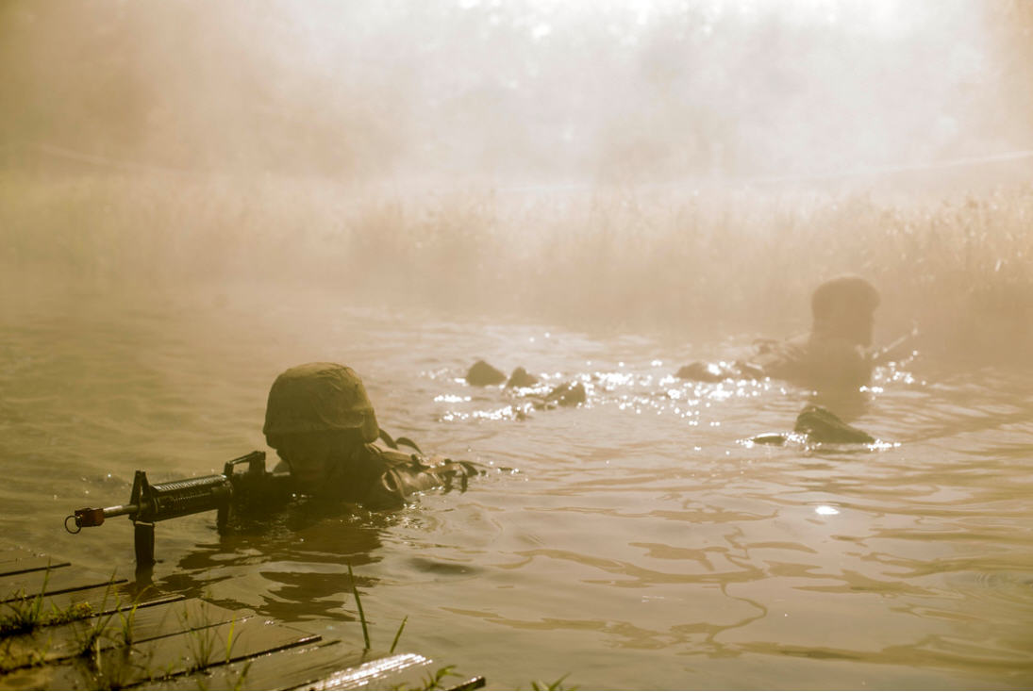
Questions?

