Slide 1
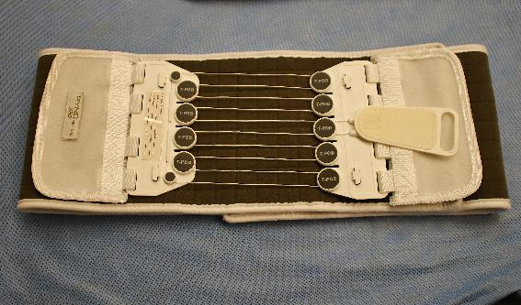
T-POD
Notes:
Read the text.

Slide 2
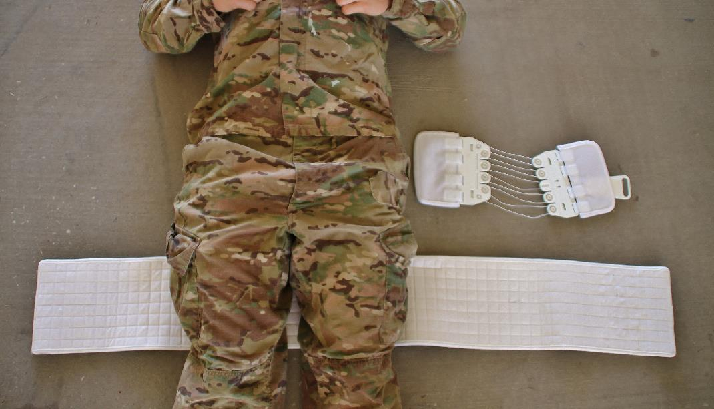
T-POD
Step 1:
Pass behind the thighs and slide upward to the correct position.

Slide 3
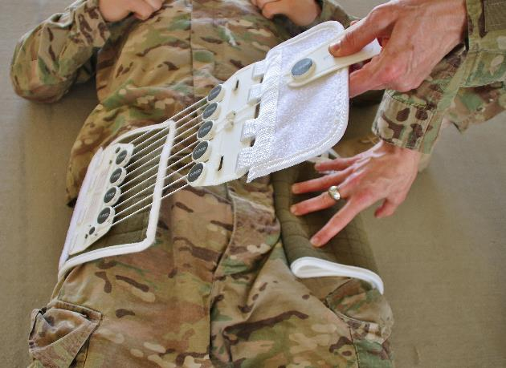
T-POD
Step 2:
Cut or fold the belt to leave a 6-8” gap in front and attach the tightening device to the belt.

Slide 4
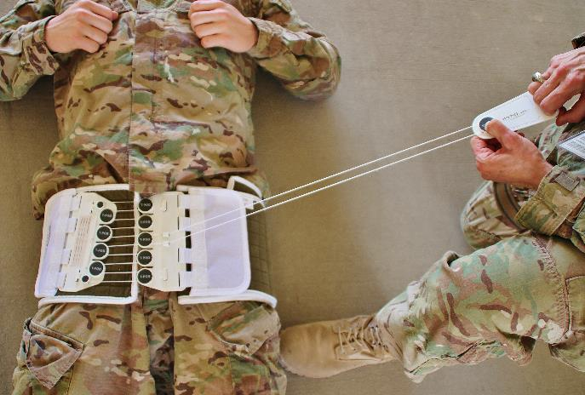
T-POD
Step 3:
Slowly tighten by pulling the tab.

Slide 5
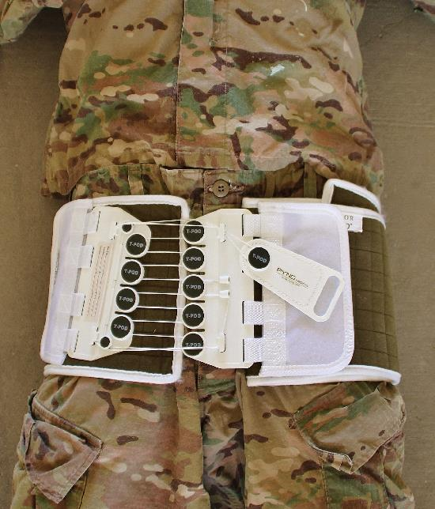
T-POD
Step 4:
Secure the cord around the hooks and the Velcro-backed pull tab to the belt.

Slide 6
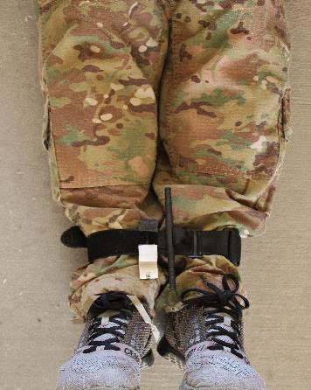
T-POD
Step 5:
Secure the ankles (not too tight)
Notes:
Note the use of a CAT here to secure the ankles and prevent external rotation of the thighs.

Slide 7
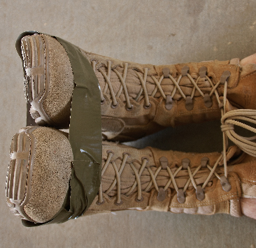
T-POD
Step 6:
Secure toes to prevent external rotation.

Slide 8
T-POD
Place holder for video.

